Slide 1
Welcome!
Sunday
Bible Study 9:30 AM
Worship 10:30 AM
PM Bible Class (Livestream) 5:00 PM
Wednesday
Bible Class 7:00 PM
www.SunsetchurchofChrist.net

Slide 2
John 8:21-30
Jesus reveals His goal
Belief in Jesus
Speaking from the Father

Slide 3
Welcome!
Sunday
Bible Study 9:30 AM
Worship 10:30 AM
PM Bible Class (Livestream) 5:00 PM
Wednesday
Bible Class 7:00 PM
www.SunsetchurchofChrist.net

Slide 4
Opening Prayer
Song – | George Watkins
Scripture Reading
Song – | George Watkins
Song – | George Watkins
Lord’s Supper
Song – | George Watkins
Collection
Song – | George Watkins
Lesson | Brian Haines
Song – | George Watkins
Closing

Slide 5
Today’s “Lifestyle” Choices
Promiscuity, fornication and adultery
Gender fluidity and homosexuality
Profanity and obscenity

Slide 6
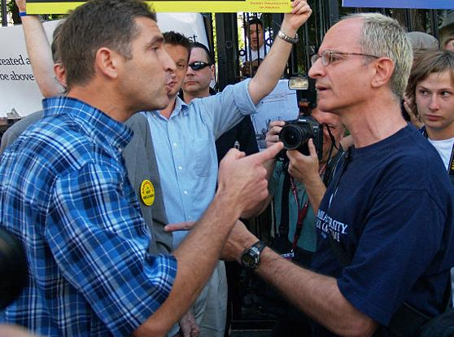
My lifestyle choices aren’t hurting you!

Slide 7
What Do We Say?
It is not easy to put a response in order
No physical harm in the moment
Suggestion that we are the antagonist
But do the choices of other matter?

Slide 8
The Big Lie: No One Hurt
2 Samuel 11
David loved Bathsheba
Murdered Uriah
Death of a child
Turmoil in the house of David
Turmoil in the nation of Israel

Slide 9
The Big Lie: No One Hurt
Genesis 30
Jacob marries four women
Bickering between the women
Uncontrollable sons
Favoritism of one son
Attempted murder and enslavement

Slide 10
The Big Lie: No One Hurt
Satan lied in the garden:
“No consequences”
The big lie today:
“No consequences”

Slide 11
Why God Made Rules
The Bible and sexuality
1) Sexuality was meant to consummate
Genesis 2:23-24
Hebrews 13:4
Notes:
Ge 2:23 And Adam said: "This is now bone of my bones And flesh of my flesh; She shall be called Woman, Because she was taken out of Man." 24 Therefore a man shall leave his father and mother and be joined to his wife, and they shall become one flesh.
Heb 13:4 Marriage is honorable among all, and the bed undefiled; but fornicators and adulterers God will judge.

Slide 12
Why God Made Rules
The Bible and sexuality
1) Sexuality was meant to consummate
2) Emotional power of sexuality unstable
Song of Solomon 8:4-7
Proverbs 6:27
Notes:
Song 8:4 I charge you, O daughters of Jerusalem, Do not stir up nor awaken love Until it pleases. 5 ¶ A RELATIVE Who is this coming up from the wilderness, Leaning upon her beloved? I awakened you under the apple tree. There your mother brought you forth; There she who bore you brought you forth. 6 THE SHULAMITE TO HER BELOVED Set me as a seal upon your heart, As a seal upon your arm; For love is as strong as death, Jealousy as cruel as the grave; Its flames are flames of fire, A most vehement flame. 7 Many waters cannot quench love, Nor can the floods drown it. If a man would give for love All the wealth of his house, It would be utterly despised.
Pr 6:27 Can a man take fire in his bosom, and his clothes not be burned?

Slide 13
Why God Made Rules
The Bible and sexuality
1) Sexuality was meant to consummate
2) Emotional power of sexuality unstable
3) Consequences of sexuality extreme
1 Corinthians 6:18-19
Notes:
1Co 6:18 Flee sexual immorality. Every sin that a man does is outside the body, but he who commits sexual immorality sins against his own body. 19 Or do you not know that your body is the temple of the Holy Spirit who is in you, whom you have from God, and you are not your own?

Slide 14
Sin Has Consequences
Jeremiah’s lament – Lamentations 1:20-22
His constant admonitions to Jerusalem
Their derision and violent rejection
POINT: Sin brings sorrow to everyone
Notes:
La 1:20 "See, O LORD, that I am in distress; My soul is troubled; My heart is overturned within me, For I have been very rebellious. Outside the sword bereaves, At home it is like death. 21 "They have heard that I sigh, But no one comforts me. All my enemies have heard of my trouble; They are glad that You have done it. Bring on the day You have announced, That they may become like me. 22 "Let all their wickedness come before You, And do to them as You have done to me For all my transgressions; For my sighs are many, And my heart is faint."

Slide 15
How Do We Respond
We believe in God
HE dictates morality
HE controls the totality of reality
HE brings the fate of people
HE judges all at the end
Notes:
Eph 5:8 For you were once darkness, but now you are light in the Lord. Walk as children of light 9 (for the fruit of the Spirit is in all goodness, righteousness, and truth), 10 finding out what is acceptable to the Lord.

Slide 16
How Do We Respond
We believe in God
Actions have consequences
It hurts us all if it angers God
It hurts us all if it is against God’s design
It hurts those who seek righteousness
Notes:
Eph 5:8 For you were once darkness, but now you are light in the Lord. Walk as children of light 9 (for the fruit of the Spirit is in all goodness, righteousness, and truth), 10 finding out what is acceptable to the Lord.

Slide 17
How Do We Respond
We believe in God
Actions have consequences
Knowing when our words matter most
Matthew 7:6
Colossians 4:6
Notes:
Mt 7:6 "Do not give what is holy to the dogs; nor cast your pearls before swine, lest they trample them under their feet, and turn and tear you in pieces.
Col 4:6 Let your speech always be with grace, seasoned with salt, that you may know how you ought to answer each one.

Slide 19
Acts 16:30
And he brought them out and said, "Sirs, what must I do to be saved?"

Slide 20
The Bible Says:
You must hear and believe
So they said, "Believe on the Lord Jesus Christ, and you will be saved, you and your household.“ Acts 16:31

Slide 21
The Bible Says:
You must confess
If you confess with your mouth the Lord Jesus and believe in your heart that God has raised Him from the dead, you will be saved. Romans 10:9

Slide 22
The Bible Says:
You must repent
For godly sorrow produces repentance leading to salvation, not to be regretted; but the sorrow of the world produces death. 2 Corinthians 7:10

Slide 23
The Bible Says:
You must be baptized
He who believes and is baptized will be saved; but he who does not believe will be condemned. Mark 16:16

